Slide 1
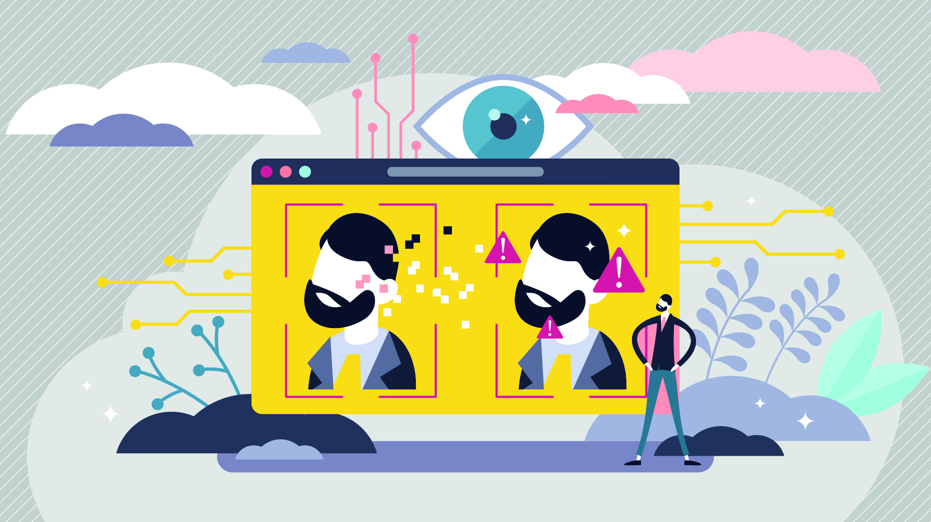
DeepFake Applications, Risks and Solutions

Slide 2
Content Overview
What is DeepFake
Background knowledge about DeepFake
Major Application fields
Risks Associated with DeepFake
Existing and potential risks brought out by DeepFake Applications
DeepFake Applications
DeepFake Applications for Fake Video, Fake Image, Fake Audio, Fake Text and some other applications
Prevention and Detection Solutions
Overview of potential solutions from technological, political, media/societal and Academic/Research perspectives
DeepFake Technology
DeepFake technologies, major advancement throughout the development process and limitations
Summary and Future Direction
Summary of important points about DeepFake
Things need to be aware of in the future

Slide 3
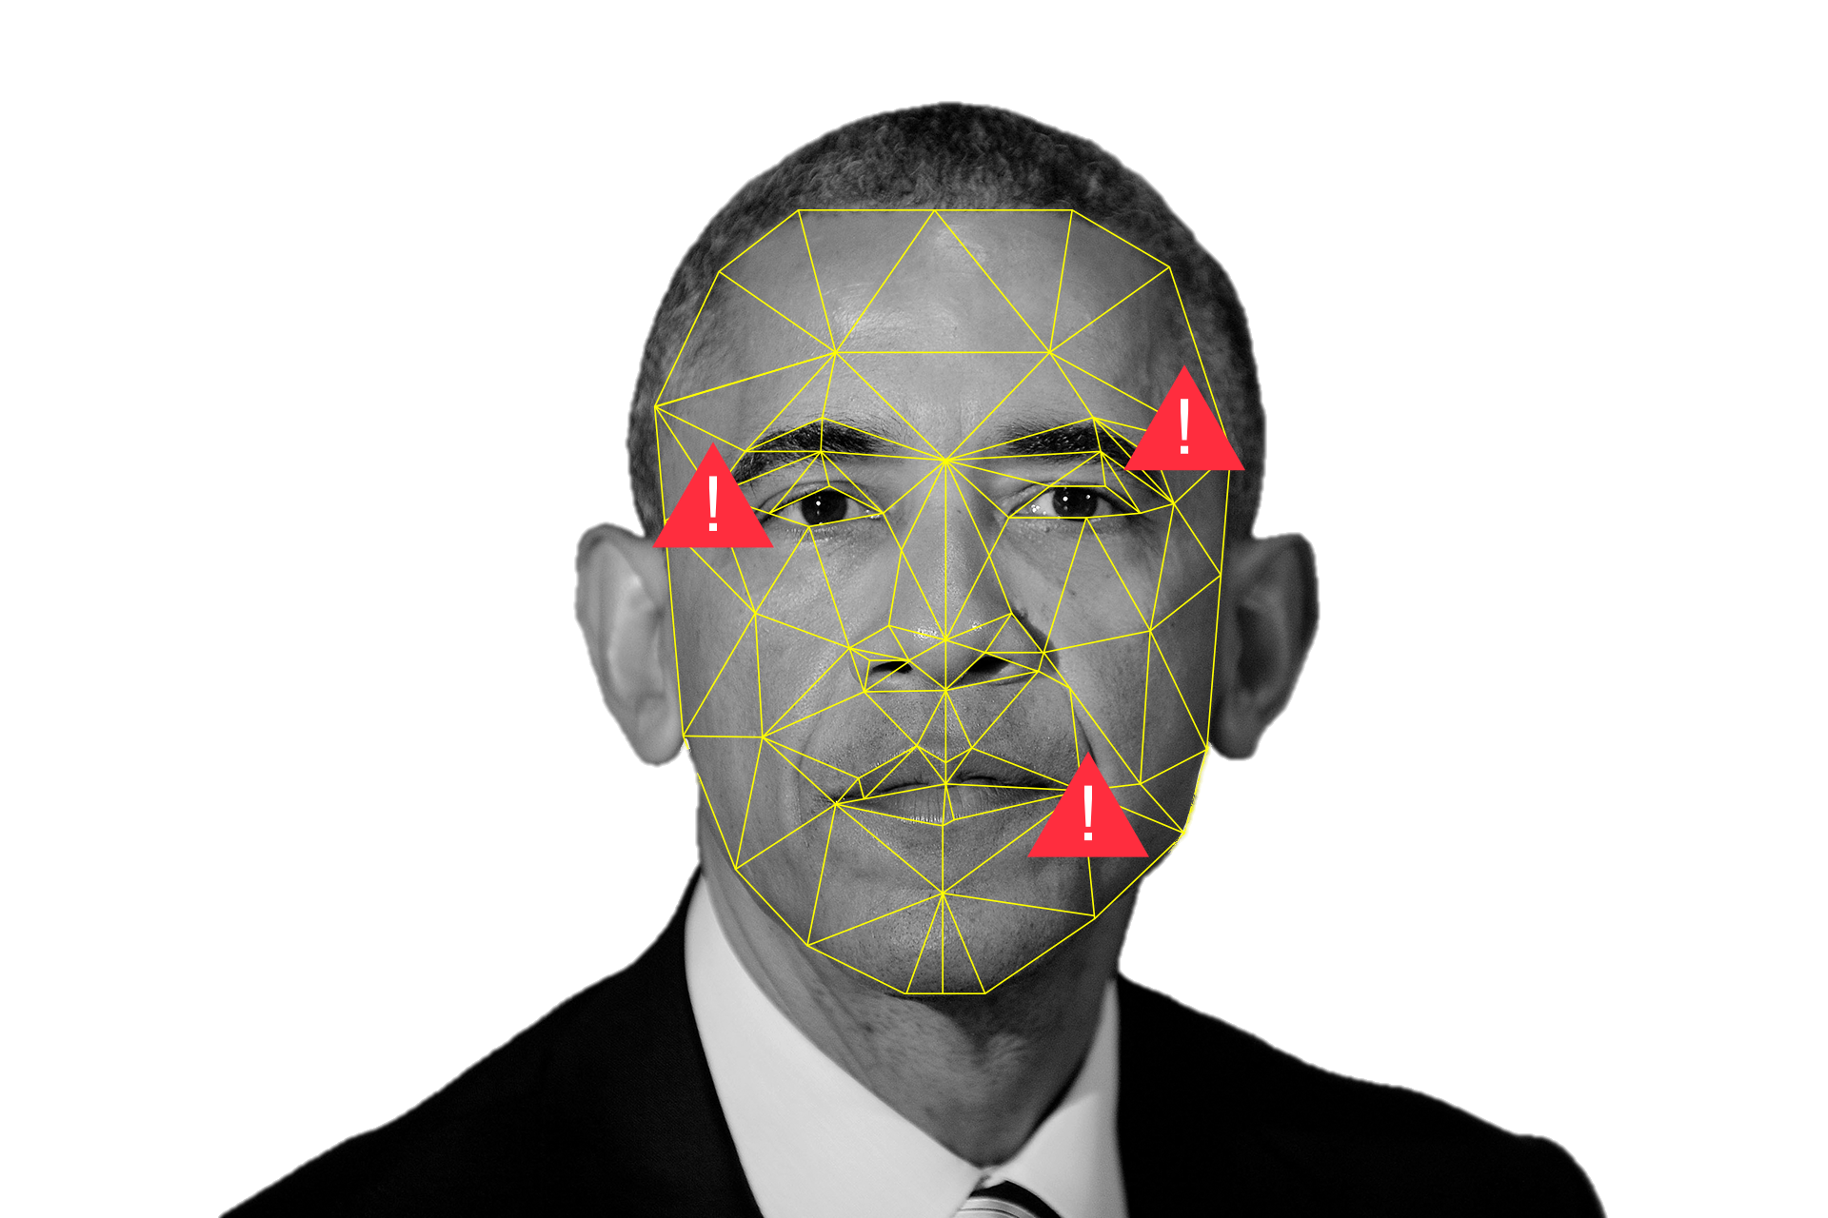
What is DeepFake
Deepfakes leverage powerful techniques from machine learning and artificial intelligence to manipulate visual and audio content. By doing so to generate synthetic media in either video form, image form, audio form, or even textual form to mimic human behavior.
The main machine learning methods involved in creating deepfakes are based on deep learning, particularly, generative adversarial networks (GAN)
Deepfakes have already gained widespread attention from their uses in the filed of creating celebrity pornographic videos, influence elections, financial fraud, etc.
Fake Video : Manipulate human in videos through face swapping, lip synching, face reenactment or attribute manipulation.
Fake Image : Manipulate image content to generate fake apparel
Fake Audio : Generation of the target speaker’s voice to portray the speaker saying something they have not said.
Fake Texts : Mimic human behavior on textual content
Other : Fake fingerprints, medical application, virtual reality technology, etc.

Slide 4
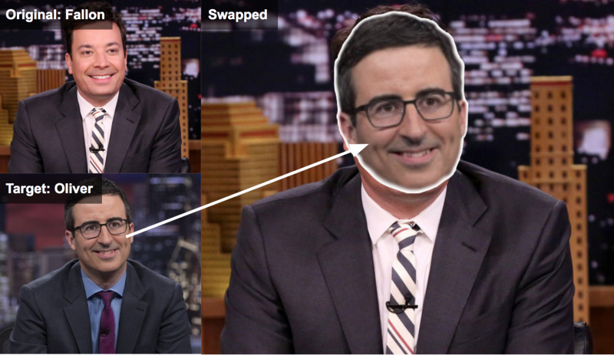
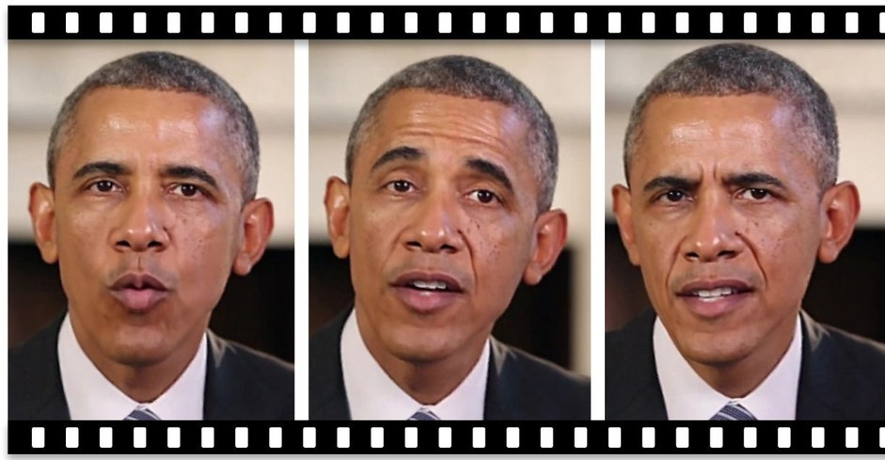
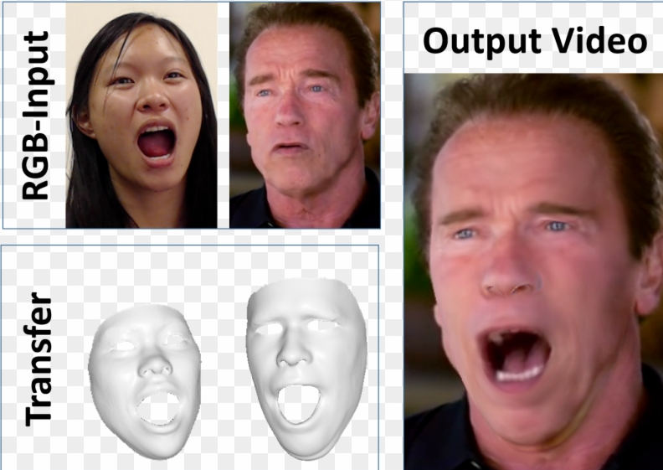
DeepFake Applications – Fake Video
Fake Video : Manipulate human in videos through face swapping, lip synching, face reenactment or attribute manipulation.
Face Swap: The face of the source person is replaced with the face of a victim
Lip Synching: The movement of the target person’s lips is manipulated to make them consistent with a specific audio recording so that the victim appears to say whatever is in the recording
Face Reenactment/Puppet Master: Videos is created which mimics the expressions of the target person, such as eye movement, facial expressions and head movement
Example: non-consensual pornographic videos,
Example: Deepfake video of former president Barak Obama giving a talk using lip syncing technology to make it l looking real, realistic video dubbing of foreign films
Example: Animating dead characters, altering published movies for making a parody/comedy/satire

Slide 5
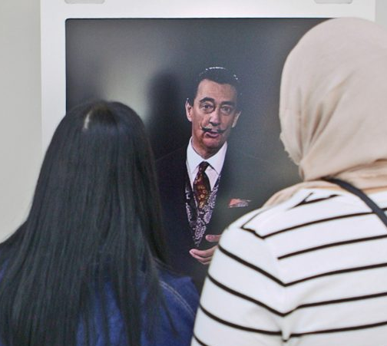
DeepFake Applications – Fake Image
Fake Image : Manipulate image content to generate fake apparel
Face Synthesis and Attribute Manipulation : Generation of photo-realistic images as well as facial attribute editing
Examples:
(Commercial) Virtually trying on clothes while shopping
(Healthcare) Inject/remove medical evidence in CT and MRI scans
(Healthcare) Offer significant diagnostic benefits
(Financial) Evade the detection of auditors to financial records
(Tourism) Generate photorealistic images of scenes
(Galleries) Generated portraits
(Galleries) Bring famous artists and their artworks to life
Dali museum, St. Petersburg, USA uses deepfake to recreate immersive visitor interaction and learning about Salvador Dali(1904-1989)

Slide 6
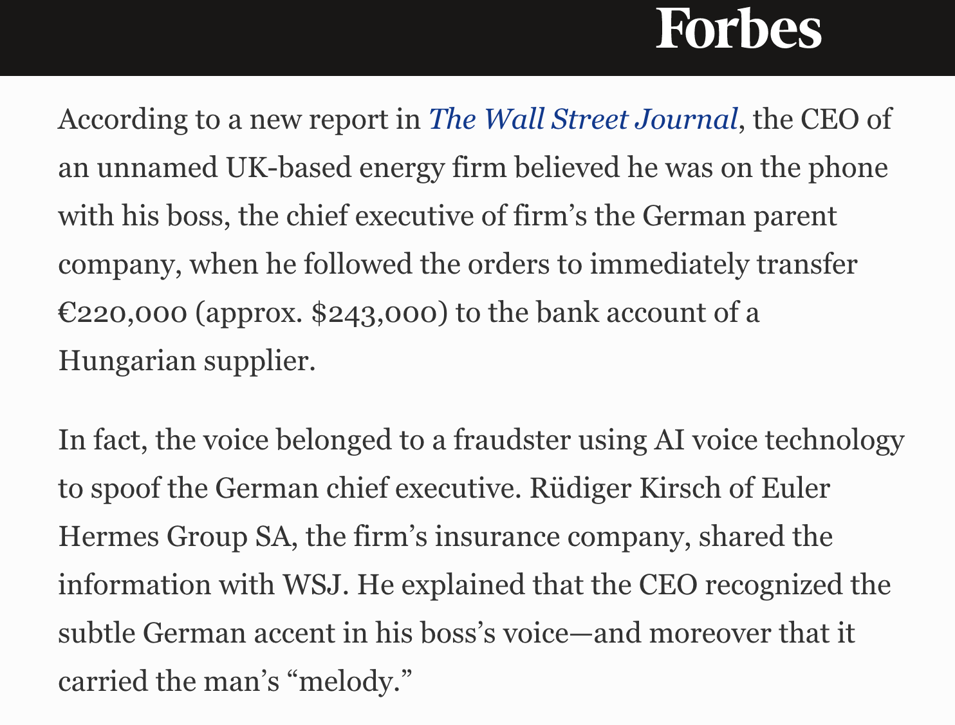
DeepFake Applications – Fake Audio
Fake Audio : Generation of the target speaker’s voice to portray the speaker saying something they have not said.
Text to speech synthesis (TTS) : Produce natural and intelligible voice waveforms, based on the provided text, that sounds like they have been spoken by the target identity
Voice conversion (VC): VC techniques transform the speech signal produced by a source speaker to seem like it was spoken by a target speaker while keeping the linguistic contents intact
Examples
Voice Cloning :
One’s voice can be cloned with only 5 seconds of audio
Synthetic voice is widely adapted for the development of different applications:
Automated dubbing for TV and film
Chatbot
AI assistants
Text readers
Personalized synthetic voices for vocally handicapped people
A Voice Deepfake Was Used To Scam A CEO Out Of $243,000

Slide 7
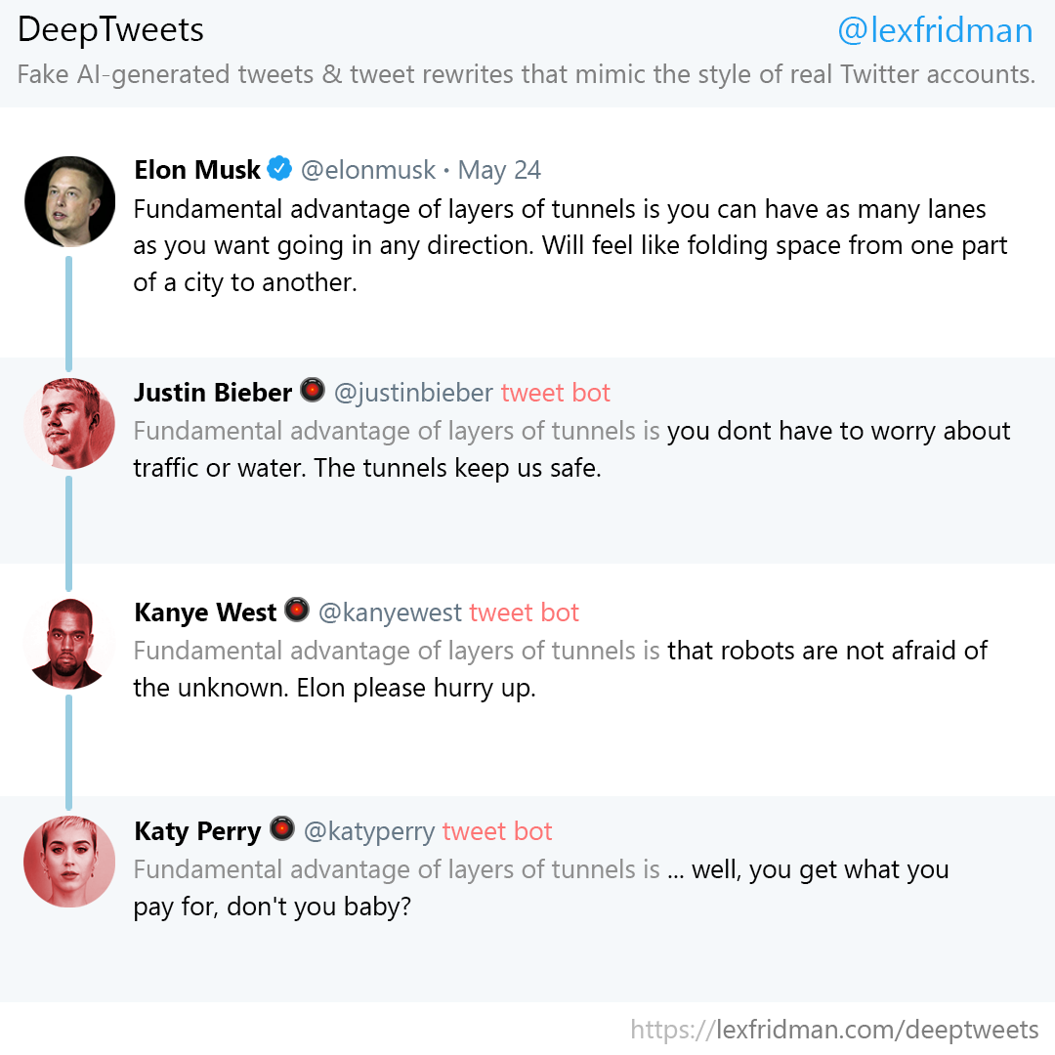
DeepFake Applications – Fake Texts and others
Fake Texts:
Generate deepfake news article
Generate deepfake tweets
Medical Field: Utilize Deepfake in therapeutical applications to help a person learn skill in virtual reality than can be transferred to physical world (As Deepfake is able to create convincing likenesses of real-world environments or people)
Fake Fingerprint: Generate realistic human fingerprints that can unlock multiple user’s devices
Combining Deepfake with other extended reality (XR) technologies: Generate realistic human fingerprints that can unlock multiple user’s devices
Entertainment, education and even retail and services
Offers the chance to be transported anywhere or any time, providing access to people and places that are either inconvenient or impossible for ones to visit
Generated Fake Tweets

Slide 8
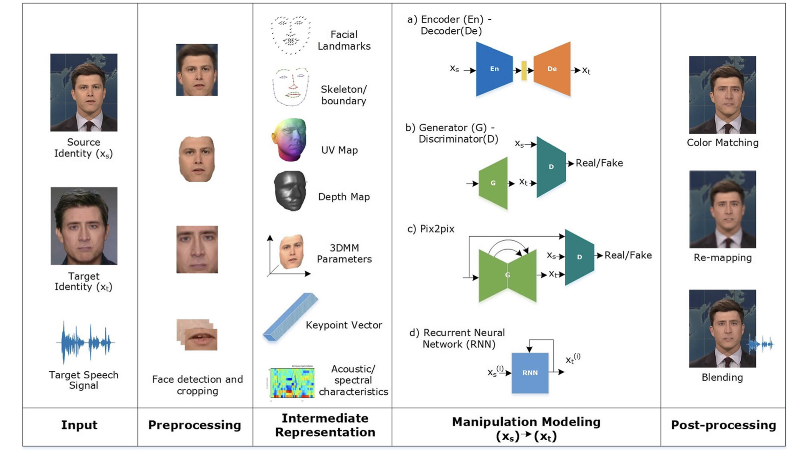
DeepFake Technology – Processing Pipeline
Encoder – Decoder Network (ED):
Consists an encoder and a decoder
Network is forced to summarize the observed concepts
Deepfake technologies often use multiple encoders or decoders and manipulate the encodings to influence the output
Generative Adversarial Networks (GAN) / Generator – Discriminator Network:
Consists two neural networks that work against each other: Generator G and Discriminator D.
G creates fake samples with the aim of fooling D while D learns to differentiate between real samples and fake samples
This game leads to G learning how to generate samples that are indistinguishable from the original distribution
After training, D will be discarded and G is used to generate content.
Processing pipeline of audio-visual deepfakes generation approaches

Slide 9
DeepFake Technology – Processing Pipeline
Image-to-image Translation (Pix2pix):
Enables paired translation from one image domain to another
This was proposed for generating high-resolution imagery with better fidelity
Recurrent Neural Network (RNN):
Handle sequential and variable length data
The network remembers its internal state after processing
In deepfake creation, RNN are often used to handle audio and sometimes video
Advance version of RNN include long short-term memory (LSTM) and gate recurrent units (GRU)
Processing pipeline of audio-visual deepfakes generation approaches

Slide 10
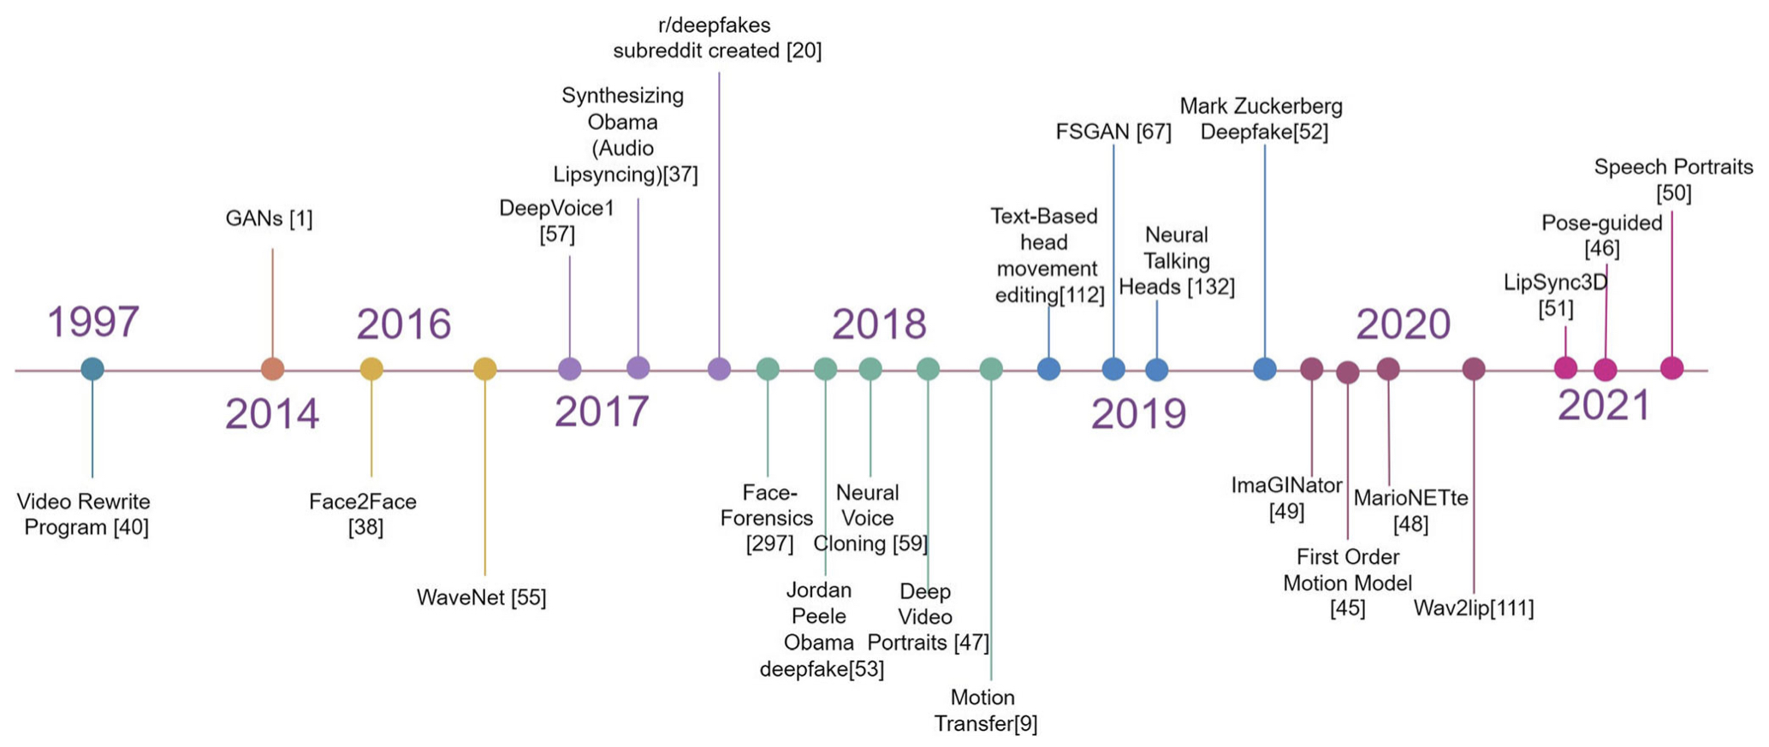
DeepFake Technology – Advancements
Unpaired self-supervised training techniques to reduce the amount of initial training data, avoid the requirement for extensive labeled training data
One/few -shot learning, which enables identity theft with a single profile picture
Improvements of face quality and identity through AdalN layers, disentanglement, and pix2pixHD network components
Fluid and realistic videos through temporal discriminators and optical flow prediction
The mitigation of boundary artifacts by using secondary networks to blend composites into seamless imagery
Use of perceptual loss on a pre-trained GG face recognition network boosts the facial quality
Use of a network pipeline gives more control over the final output
Timeline of the evolution of Deepfakes

Slide 11
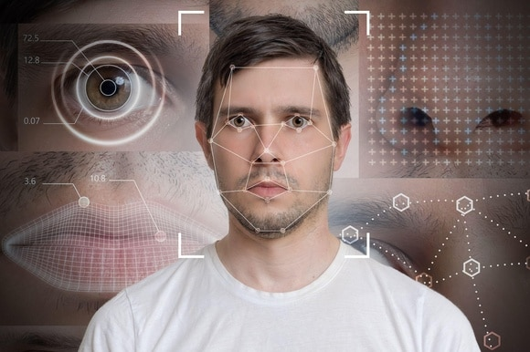
DeepFake Technology – Challenge and Limitation
Generalization
High-quality images of a specific identity requires a large number of samples of that identity
Paired Training
One way to train a neural network is to present the desired output to the model for each given input, which is laborious and impractical sometimes.
Identity Leakage
Sometimes the identity of the replacement is partially transferred
Occlusions
Where part of the face is obstructed with a hand, hair, glasses or any other item, as a result, artifacts appear such as cropped imagery or inconsistent facial features.
Temporal Coherence
Most deepfake networks process each frame individually with no context of the preceding frames

Slide 12
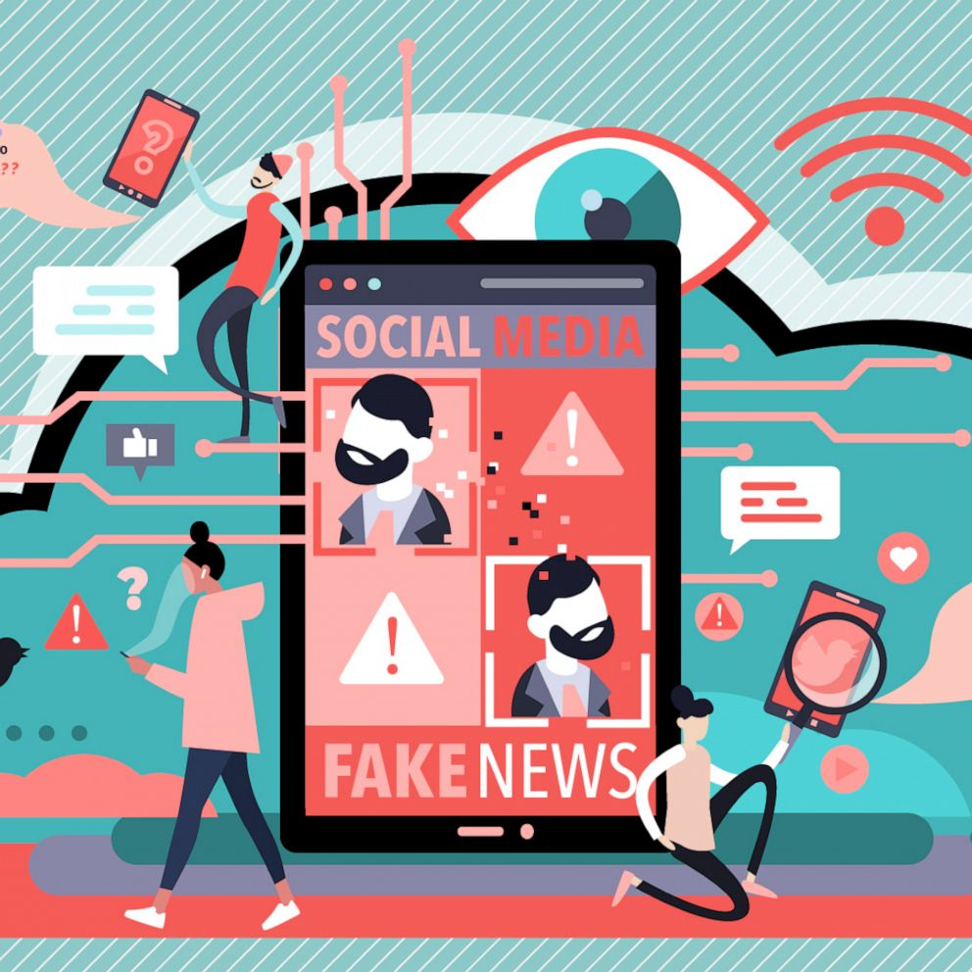
Risks Associated with DeepFake
Propagation/Spread of Misinformation
Pollute Information Source
Trigger severe complications in society
Misrepresentation, confusion and erosion of trust about a destination
Loss of credibility in state institutions, electronic media and others
Authentication Challenge
Face ID
Fingerprint ID
Threat to automated speaker verification systems e.g., Voice ID
Threat to voice-controlled systems deployed on the Internet of Things (IoT)
Scams and Fraud
Tampering of evidence: Medical, Forensic, Court
Empower criminals to manipulate business dealings
Generating fake artwork
Financial Fraud: Falsify audit records, Insurance Fraud
Reputation Damage/Harming Credibility
Revenge porn
Political sabotage via generated videos or articles
Defamation of public person
Impersonation of individuals

Slide 13

Risks Associated with DeepFake
Damage brought out by Deepfake Pornography
Facilitate image-based sexual abuse
Non-consensual creation
Distribution
threat of distribution of explicit content
Revitalize “revenge pornography” and sextortion
Mental Damage: Victimization is associated with Psychological
distress, Diagnosis of moderate to severe depression, Anxiety disorder,
Suicide
Misdirection of Public Opinion
Generated discourse to amplify events/facts
Defamation of innocent individuals
Inflammation of popular sentiment
Political Warfare Affects Election Results
Election Manipulation
Tone change of articles
Content loosely based on facts
Create Conspiracy
Impersonation of political leaders­
National Security
Spark or justify a war
Deceive military analysts with fake information

Slide 14
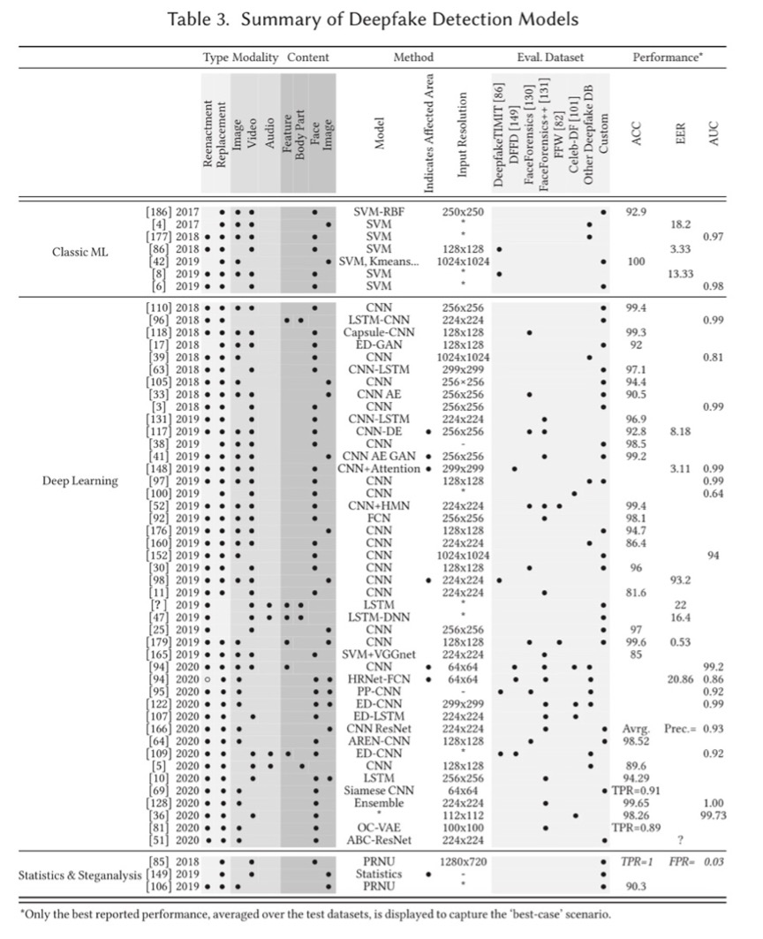
Prevention and Detection Solutions - Technological
DeepFake Detection Technologies
Detect deepfakes by searching for specific artifacts:
spatial artifacts: inconsistencies, abnormalities in background, GAN fingerprints, in blending, environments and forensic
temporal artifacts: detecting variation in a person’s behavior, physiological signals, frame synchronization and coherence
Technology companies such as Facebook, Twitter and Google are releasing database of deepfakes to improve identification
Data Provenance Technologies
Data provenance of multimedia should be tracked through distributed ledgers and blockchain networks
Content should be ranked by participants and AI
Contents should be authenticated and managed as a global system
Counter Attacks Technologies
Adversarial machine learning can be used to disrupt and corrupt deepfake networks. Can prevents deepfake technologies from locating a proper face.
Use adversarial noise to change the identity of the face so that web crawlers will not be able to find images to train model
Summary of DeepFake Detection Models

Slide 15

Prevention and Detection Solutions – Laws and Regulations
Child Pornography Laws
Protect against the depiction of any person under the age of 18 in pornography and specify that this includes material produced using electronics/mechanical means
Production of deepfake videos with the face of minor and poster of such video would be prosecuted as an act of distribution child pornography
Protection against revenge pornography
Stipulates that the publication of an intimate image without consent is reprehensible by law
The law covers sexual or nude images of a person that were produced using pyrographic, film or video recording
[Need Expansion]: Deepfake pornography, which is algorithmically synthesized, is open to interpretation
Misappropriation of Personality
Legislation in place that prohibits the use of a person’s likeness for commercial purposes
Posting a deepfake pornographic video/fake generated other content that in se of a person’s personality/face/identity on a website that monetizes it in sole capacity, or monetizing traffic could represent a cause of action. This also put pressure on websites to be more active in betting materials

Slide 16


Prevention and Detection Solutions –
Societal/Media & Academic/Research
Societal/Media
Raise public awareness
Provide internet literacy
Help individuals spot deepfakes material when they encounter it
Teach individuals to critically think about every piece of media they come across online
Educational Efforts for Bystanders
Better support for victims
Academic/Research
Examine the attitudes surrounding deepfake pornography/other crimes
Assess attitudes of police forces on TFSV (Technology-Facilitated Sexual Violence) and deepfake and other deepfake related crimes
Investigate potential impact of deepfakes on attitudes related to sexual norms and scripts, consent and sexual behaviours

Slide 17

Summary and Future Direction
Summary:
Deepfake technologies utilizes deep learning methods such as Generative Adversarial Networks. Over the years, there have been huge improvements and advancements in making the fake content be more real.
Current limitations still include fixing unreal features in the generated fake content, insufficient original data is another main problem and limitation
Despite the benefits deepfake technologies has brought, it has significant downsides: spreading of misinformation, defamation of individuals, scams and frauds, influence elections, etc. These negative sides is shaking the whole society.
Current law and regulations is insufficient to protect most victims. With the existing difficulty in convicting cyber crime, current law and regulation needs expansion to help the victims more
Future Direction:
The race between development of Deepfake technology and the development of prevention and detection technology
Balance the positive and negative impact

Slide 18
References
[1] Y. Mirsky and W. Lee, “The Creation and Detection of Deepfakes: A Survey,” ACM computing surveys, vol. 54, no. 1, pp. 1–41, 2021, doi: 10.1145/3425780.
[2] V. Karasavva and A. Noorbhai, “The Real Threat of Deepfake Pornography: A Review of Canadian Policy,” Cyberpsychology, behavior and social networking, vol. 24, no. 3, pp. 23–209, 2021, doi: 10.1089/cyber.2020.0272.
[3] A. O. J. Kwok and S. G. M. Koh, “Deepfake: a social construction of technology perspective,” Current issues in tourism, vol. 24, no. 13, pp. 1798–1802, 2021, doi: 10.1080/13683500.2020.173835
[4] M. Masood, M. Nawaz, K. M. Malik, A. Javed, A. Irtaza, and H. Malik, “Deepfakes generation and detection: state-of-the-art, open challenges, countermeasures, and way forward,” Applied intelligence (Dordrecht, Netherlands), 2022, doi: 10.1007/s10489-022-03766-z.
[5] B. K. Wiederhold, “Can Deepfakes Improve Therapy?,” Cyberpsychology, behavior and social networking, vol. 24, no. 3, pp. 147–148, 2021, doi: 10.1089/cyber.2021.29209.editorial.
[6] J. Kietzmann, A. J. Mills, and K. Plangger, “Deepfakes: perspectives on the future ‘reality’ of advertising and branding,” International journal of advertising, vol. 40, no. 3, pp. 473–485, 2021, doi: 10.1080/02650487.2020.1834211.

